Slide 1
Two slopes
Two toy cars move along the same straight line.
Start
Finish
Notes:
https://pixabay.com/en/automobile-woman-blond-car-driver-160339/
https://pixabay.com/en/frankenstein-halloween-automobile-160358/

Slide 2
Two slopes
This graph shows a distance - time graph for the two toy cars.
Distance from start / cm
20
0
0
1
2
3
4
5
6
7
8
9
Time / s

Slide 3
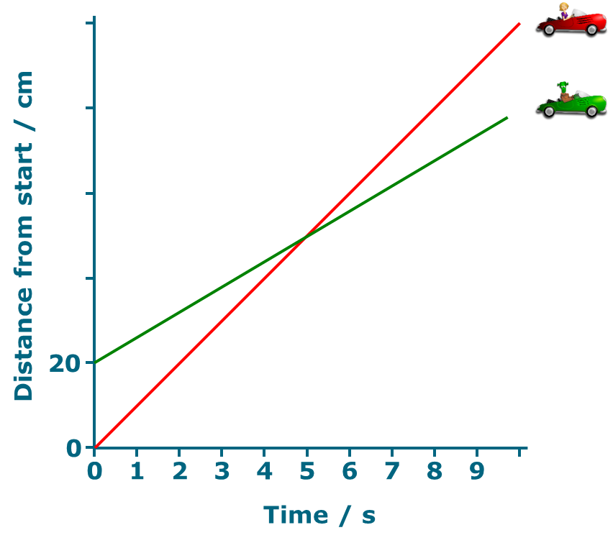
Two slopes
1. At the moment t=2s, which car has a bigger speed?
A
Red car
B
Green car

Slide 4
Two slopes
2a. Do the cars ever have the same speed?
A
Yes
B
No

Slide 5
Two slopes
2b. What is the best reason for your answer to the last question?
2a. Do the cars ever have the same speed?
A
The red car goes further
B
The red line is always steeper
C
The lines cross at 5 seconds

